Slide 1
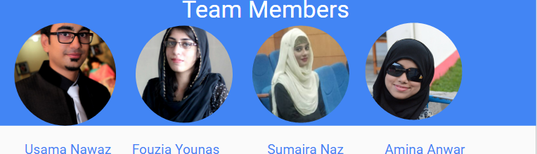
Save Life: A Blood Bank Application

Slide 2

Value Proposition:
Reducing Gap between Donors and Receipients
Problem/solution overview:
Targeted towards users who don’t find blood on time. We want this app to create a bridge between people to help
them to get out out of the panic situation.
Notes:
Developmental milestones
Create community
Focus on memories associated with developmental milestones

Slide 3

Three Tasks
Store Health Tips and Screening information
Provide quick response to receipients
Find Reliable donors and managing their information
(simple)
(medium)
(complex)
Notes:
Listed in order of complexity → simple, medium, complex
All tasks are simple by construction, but could see lightest users just using it to view goals, medium users just trying to find resources to meet goals, and power users storing memories in the form of pictures and videos.
Be able to view goals by age
Be able to keep track of more than one kid
Resources include network of other parents

Slide 4
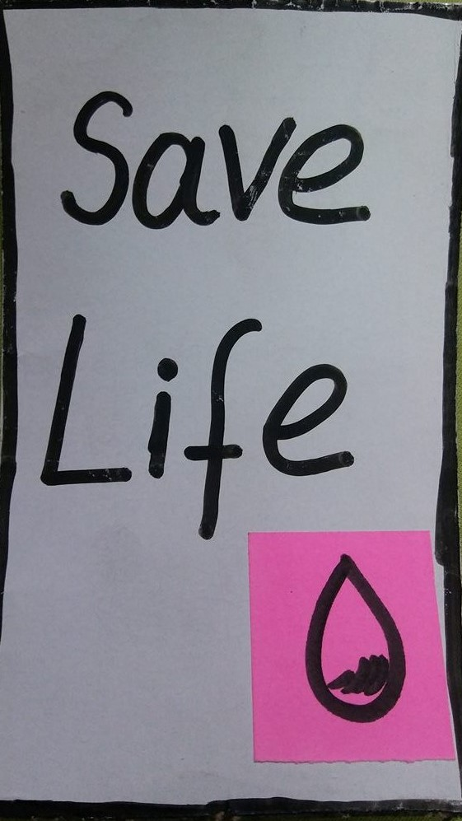
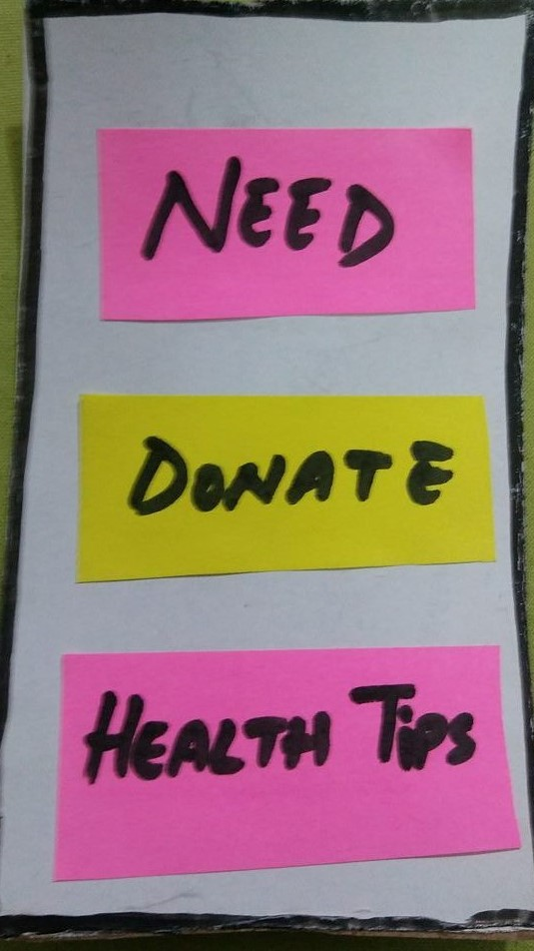
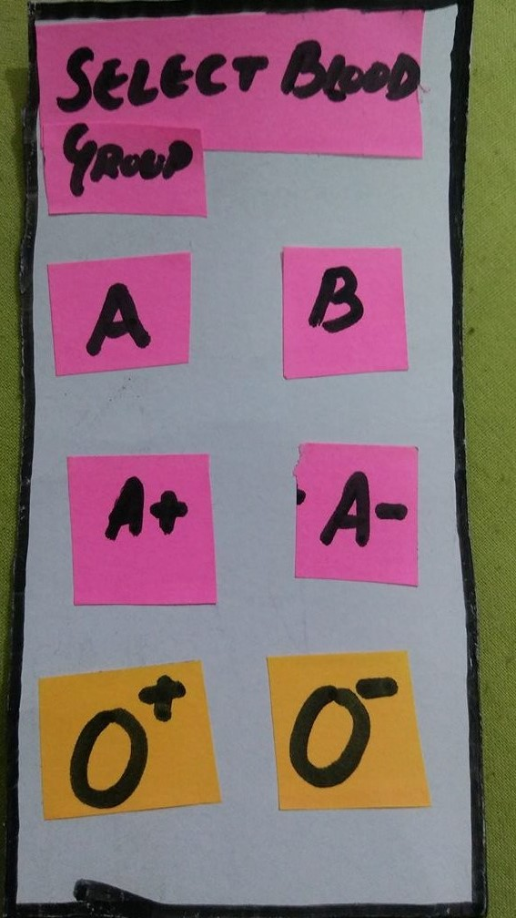
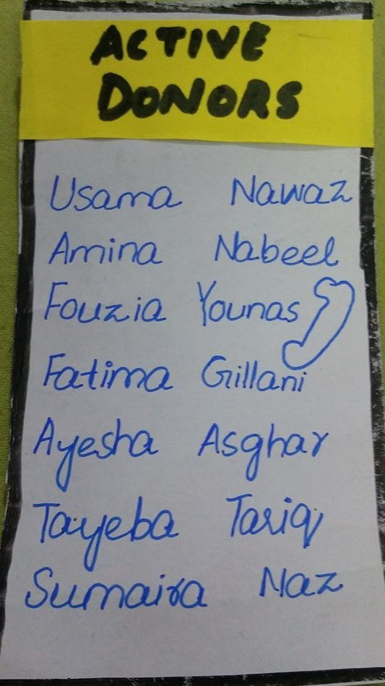
Storyboarding

